Slide 1

CLUSTERING GLOBAL DEVELOPMENT
Presented by
P483 – Group 1
- T.LITHEESH KUMAR
- DURGAPRASAD KAKARA
- DARSHITH RAJ KATEPOGU
- B.SAI KEERTHI
- MOHAMMAD ISMAIL
- GONUGUNTLA KUMAR

Slide 2
PROBLEM STATEMENT
- Creating clusters on global development measurement dataset.
DATASET
The dataset has information about important economic and development metrics related to various countries across the globe.
The dataset has 2704 rows with 25 columns.
It has 6 object, 17 float, 2 int

Slide 3

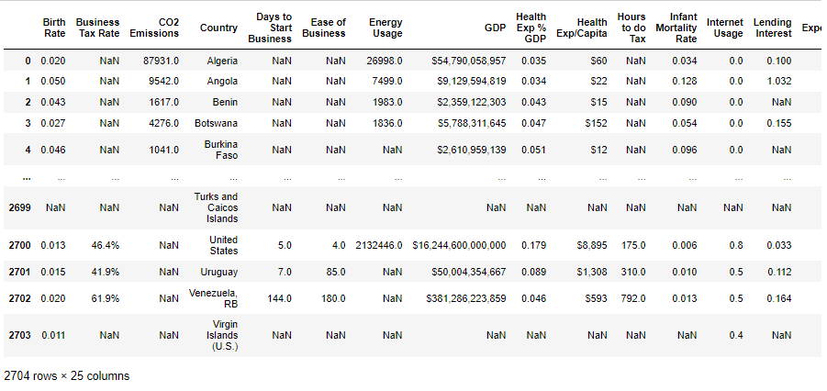
OVERALL, VIEW OF THE GIVEN DATA

Slide 4
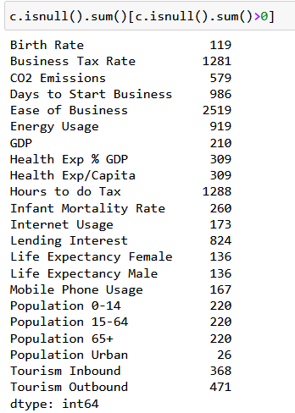
Missing values
We'll fill missing values by three ways:
Dropping Columns with High Missing Values
Filling Numerical Columns with Mean
Filling Categorical Columns with Mode

Slide 5
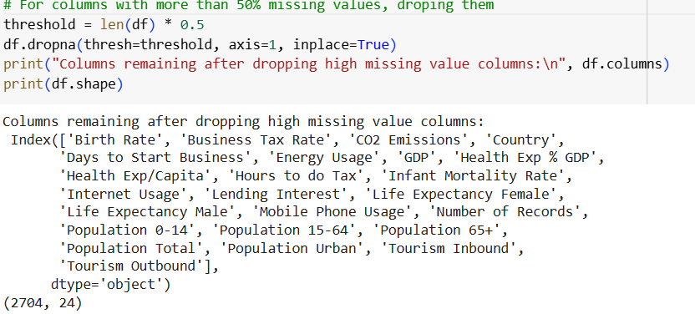
1. Dropping columns with high missing values
If a columns have a large proportion of missing values e.g., Ease of business has 2,519 missing values out of 2,704 it might be practical to drop them, because they don’t contribute much to analysis.

Slide 6
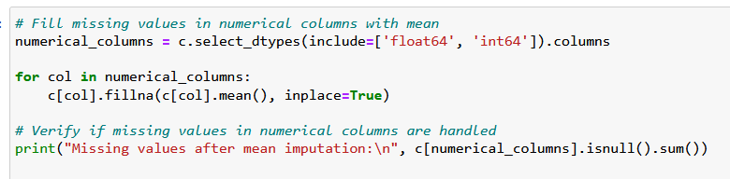
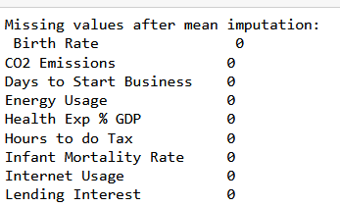
2. Filling Numerical Columns With Mean

Slide 7
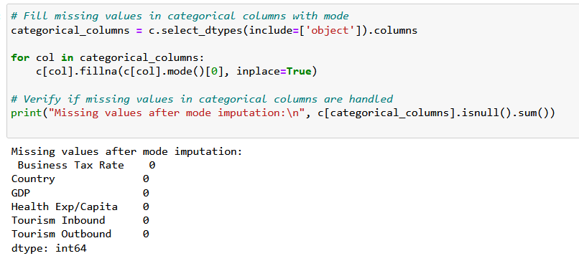
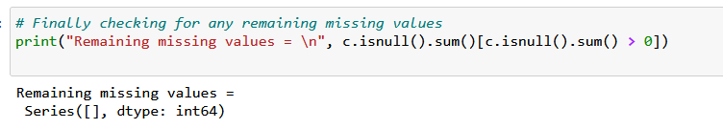
3. Filling Categorical Columns with Mode
Re-checking Again

Slide 8
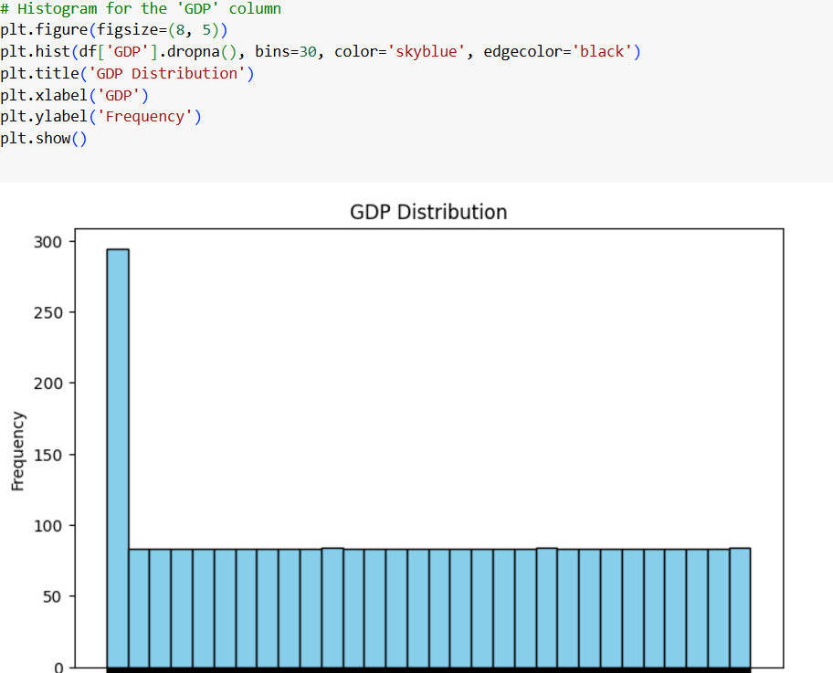


EDA
Histogram for numerical columns
Histograms show the distribution of individual numerical columns, which is useful for understanding data spread, skewness, and common values.

Slide 9
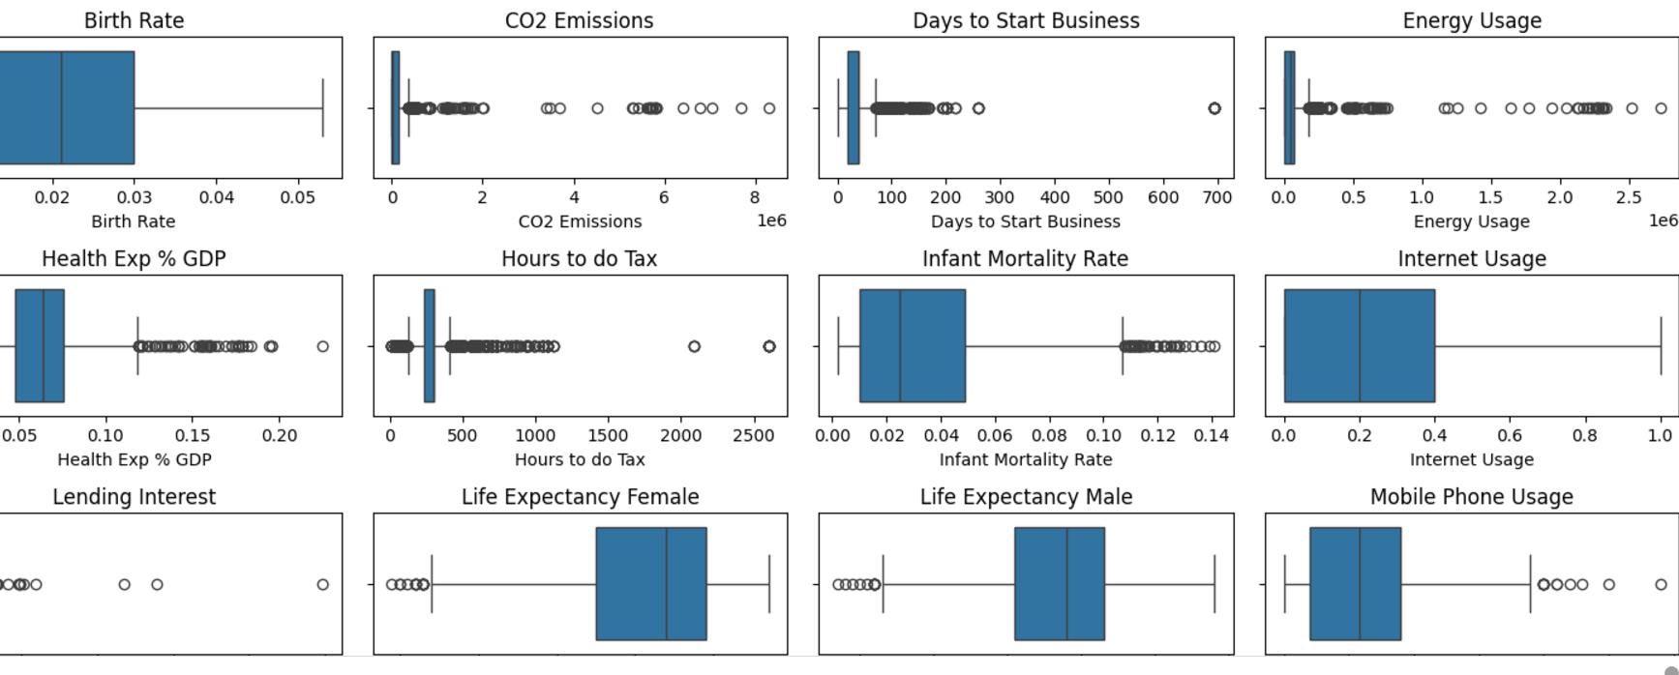
Box Plot
Box plots help detect outliers in numerical columns by showing the spread and identifying extreme values.

Slide 10
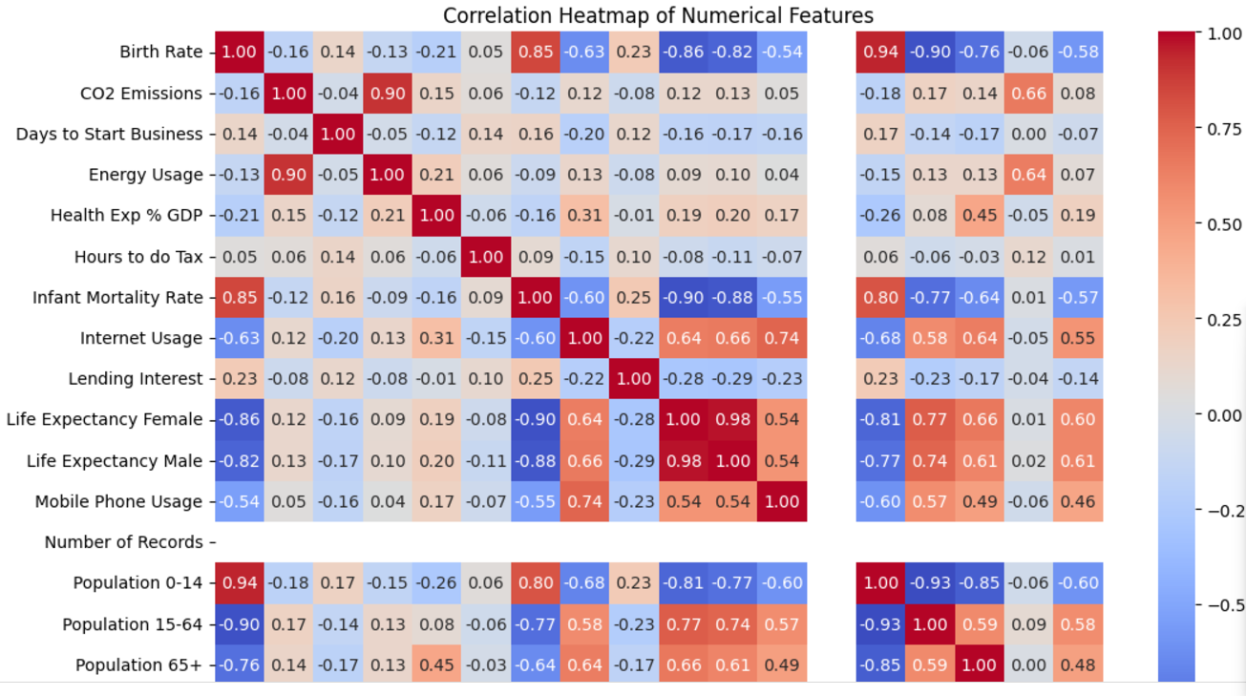
Correlation Heatmap
A heatmap of correlations helps reveal relationships among numerical features, indicating how they might interact with each other.

Slide 11
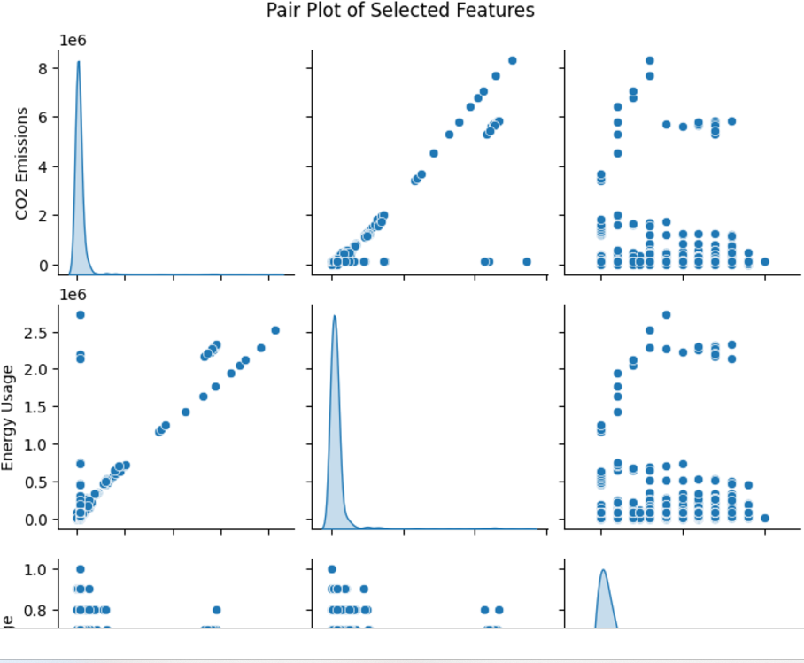
Pair plot
Pair plots allow you to visualize the relationships between several numerical features at once, showing distributions on the diagonal and scatter plots on the off-diagonals.

Slide 12
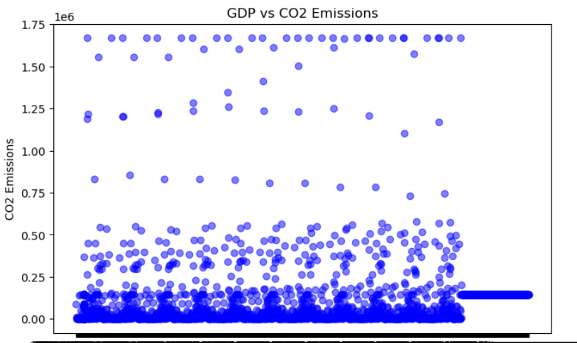
Scatter PLot
It help visualize the relationship between two numerical columns.

Slide 13
Conclusion on EDA
The analysis of socio-economic and environmental indicators across countries provided meaningful insights into global trends, disparities, and relationships across various dimensions. Key findings from this analysis include:
1) Economic Strength:
Countries with higher average GDP emerged as economically influential, while others lagged behind, illustrating global economic disparities. This variation highlights the need for balanced economic policies to support growth in less prosperous regions.
2) Health and Demographics:
Differences in life expectancy showed a gender pattern favoring females, consistent with global health trends. Infant mortality rates varied significantly, serving as a key indicator of healthcare quality and resource allocation gaps across nations.

Slide 14
SUMMARY
SUMMARY:
This analysis underscored significant economic, environmental, and social differences across countries, providing a comprehensive view of global development priorities and challenges.
These findings serve as a strong foundation for further analysis, such as clustering, which can categorize countries with similar socio-economic profiles.
Such insights can guide targeted policies and strategic initiatives aimed at fostering balanced and sustainable global development.

Slide 15

STANDARDIZING THE DATA BY USING NORMALIZATION
Normalizing the features using standardscalar to prevent large ranged features dominancy and to improve the model performance
Standardizer = standardscalar()
Features_standardized = standardizer.fit_transform(features)

Slide 16
MODEL BUILDING
We are using three clustering methods in this project
1.K Means Clustering
2.Hierarchical Clustering
3.DBSCAN Clustering

Slide 17
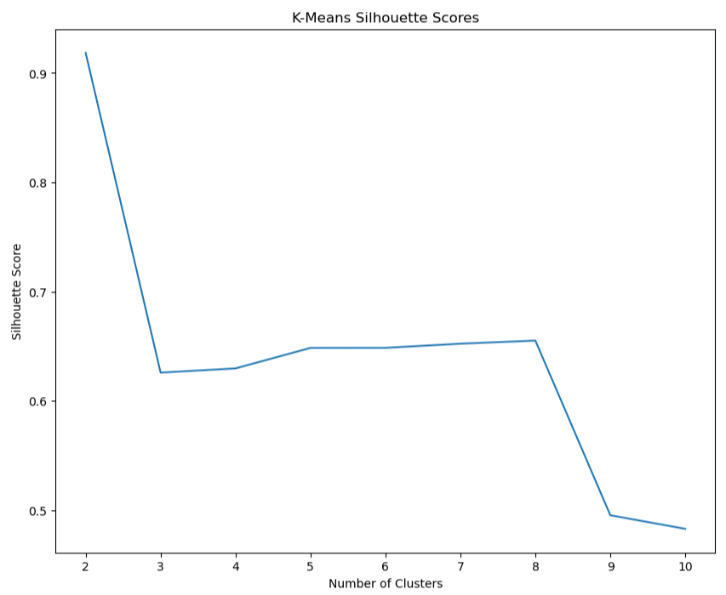
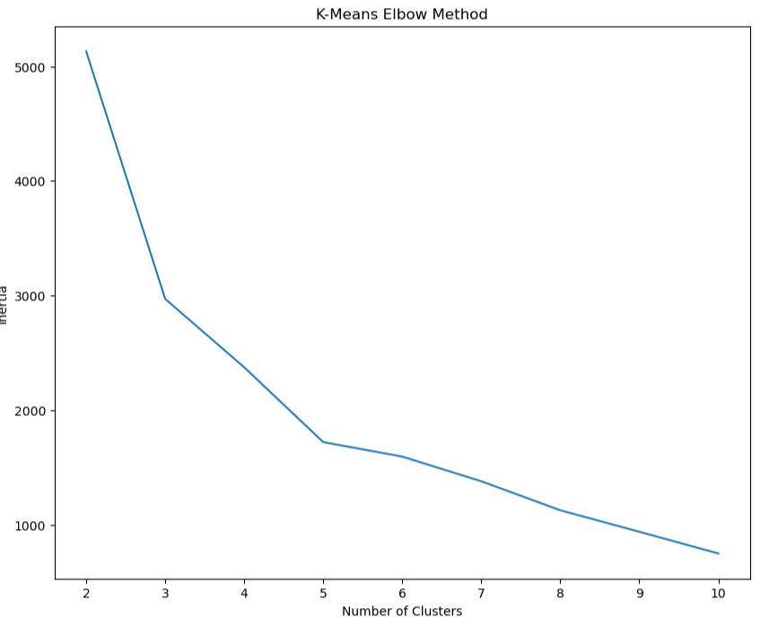
K Means Clustering
K-Means Clustering:
Groups data into K clusters by
minimizing the variance within
each cluster.

Slide 18
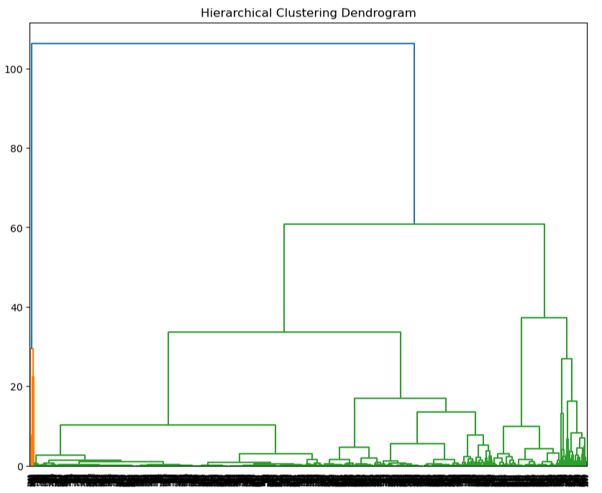
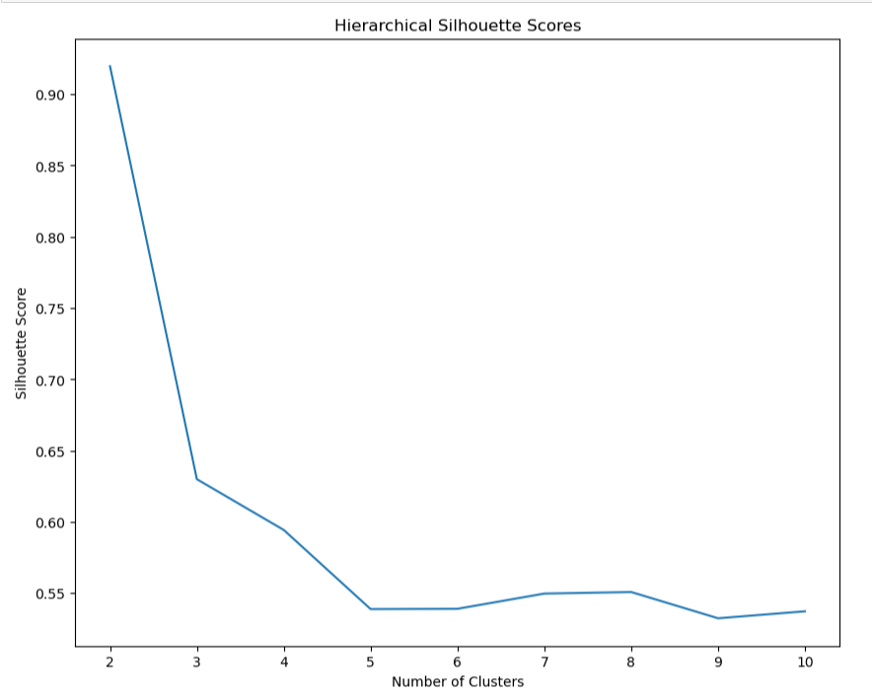
Hierarchical Clustering
Hierarchical Clustering:
Builds a hierarchy of clusters
using a tree-like structure
for merging or splitting.

Slide 19
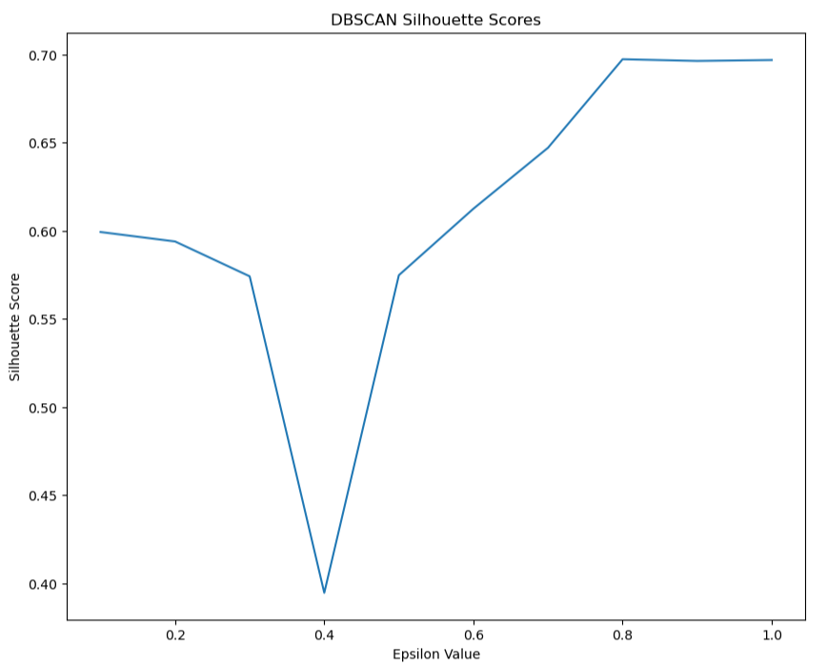
DBSCAN Clustering
DBSCAN Clustering:
Identifies clusters of varying
shapes by focusing on
density-connected regions.

Slide 20
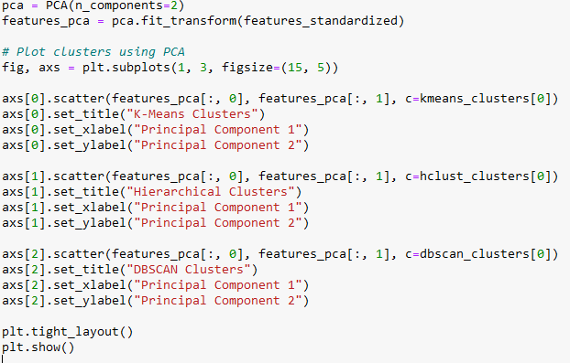
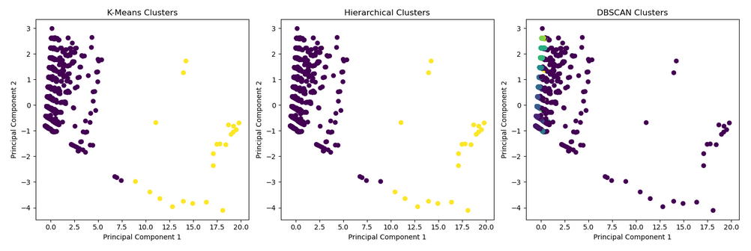
Principal Component Analysis (PCA)
PCA is a dimensionality reduction technique used to simplify complex datasets by transforming them into a smaller set of components while preserving the most significant information.
We applied PCA to reduce the number of features in the dataset, addressing high-dimensionality issues.

Slide 21
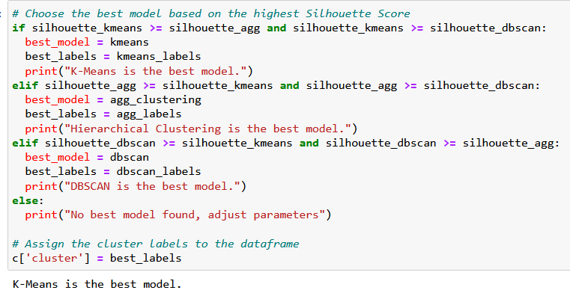
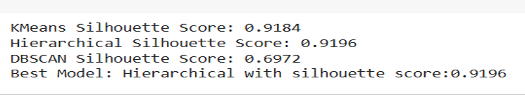
CALCULATING SILLHOUETTE SCORE

Slide 22


As we can see here DBSCAN and K Means both were not able to match the silhouette score of model building well on the other hand Hierarchical Clustering had a great silhouette score so we chose it for the
model building.

Slide 23
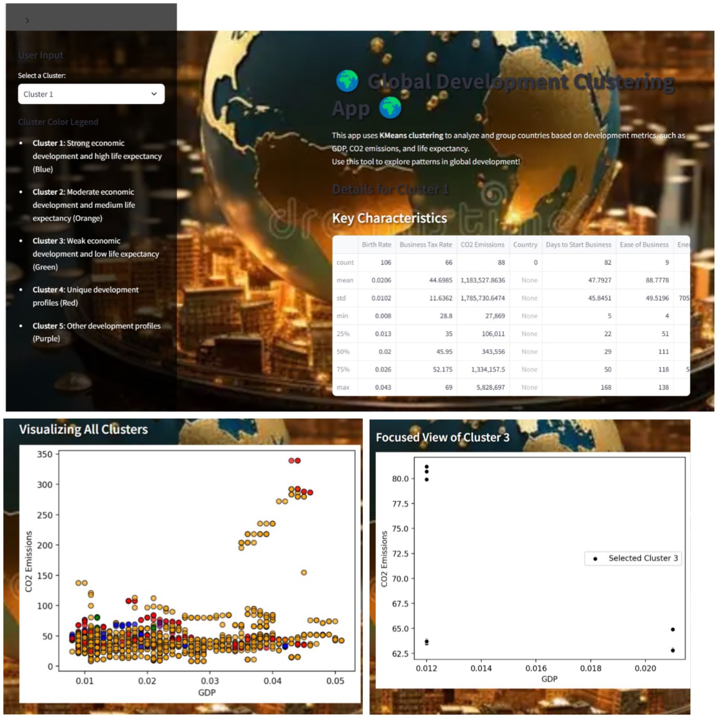
DEPLOYMENT USING STREAMLIT

Slide 24
Challenges Faced
https://chatgpt.com/share/67595009-93f0-8012-95a2-4903bc110617M
https://chatgpt.com/share/67595022-2dbc-8012-bbac-66441c0ed5f9
https://chatgpt.com/share/6759507f-21d4-8012-b38c-eff62b7aeb01
https://chatgpt.com/share/67595050-22bc-8012-9fa7-5ced28933049

Slide 25


